Slide 1
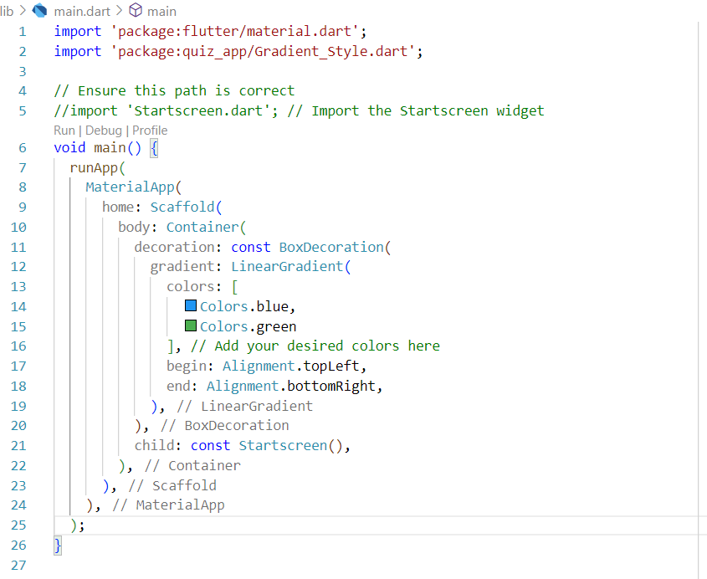
This so far has provided me the colour of the front screen

Slide 2
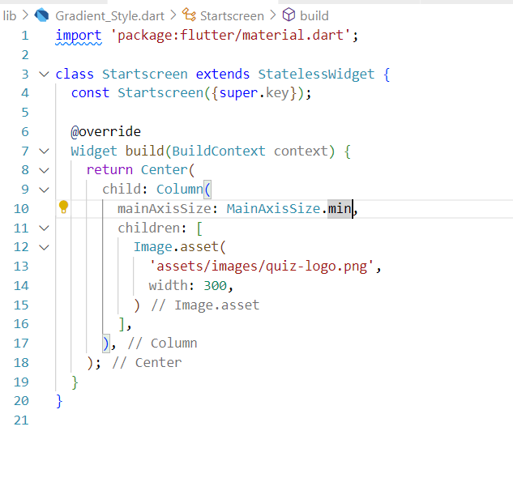
An image has been displayed on emulator screen now.

Slide 3
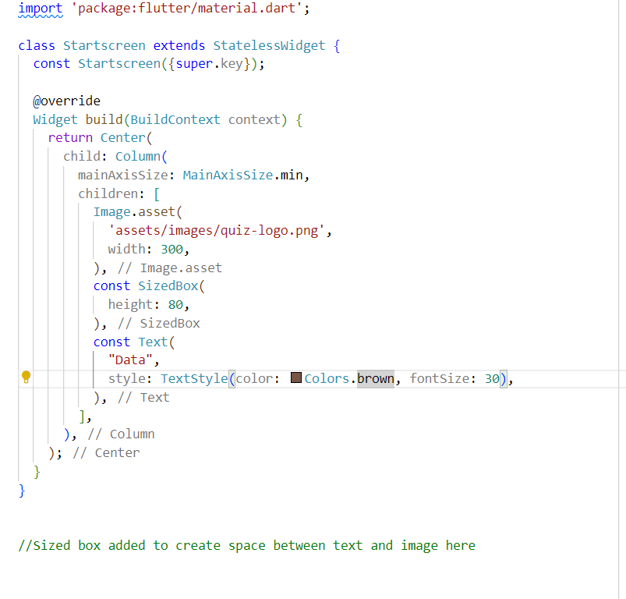
Added a text gave space using size box now added colour to the text as you can see below.

Slide 4
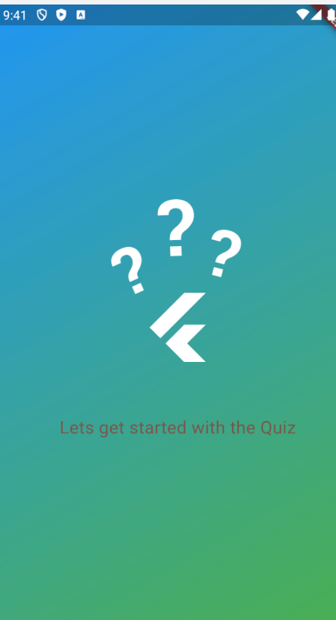
Result till here.

Slide 5
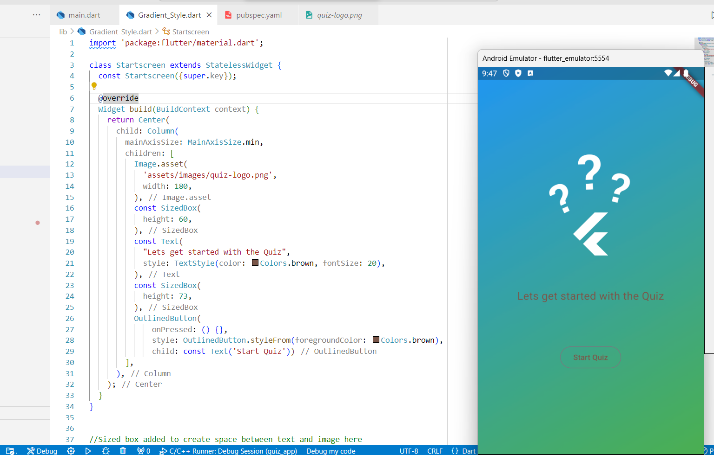
Create an outlined button used Outlined button style from foreground colour inside the outline button class with in it used style from.

Slide 6
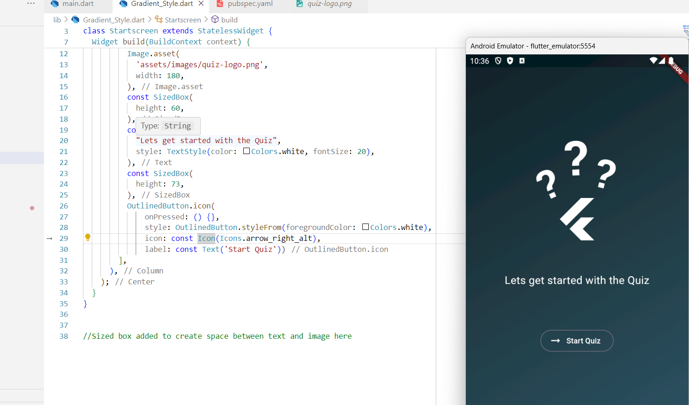
Adding icons to a button.

Slide 7
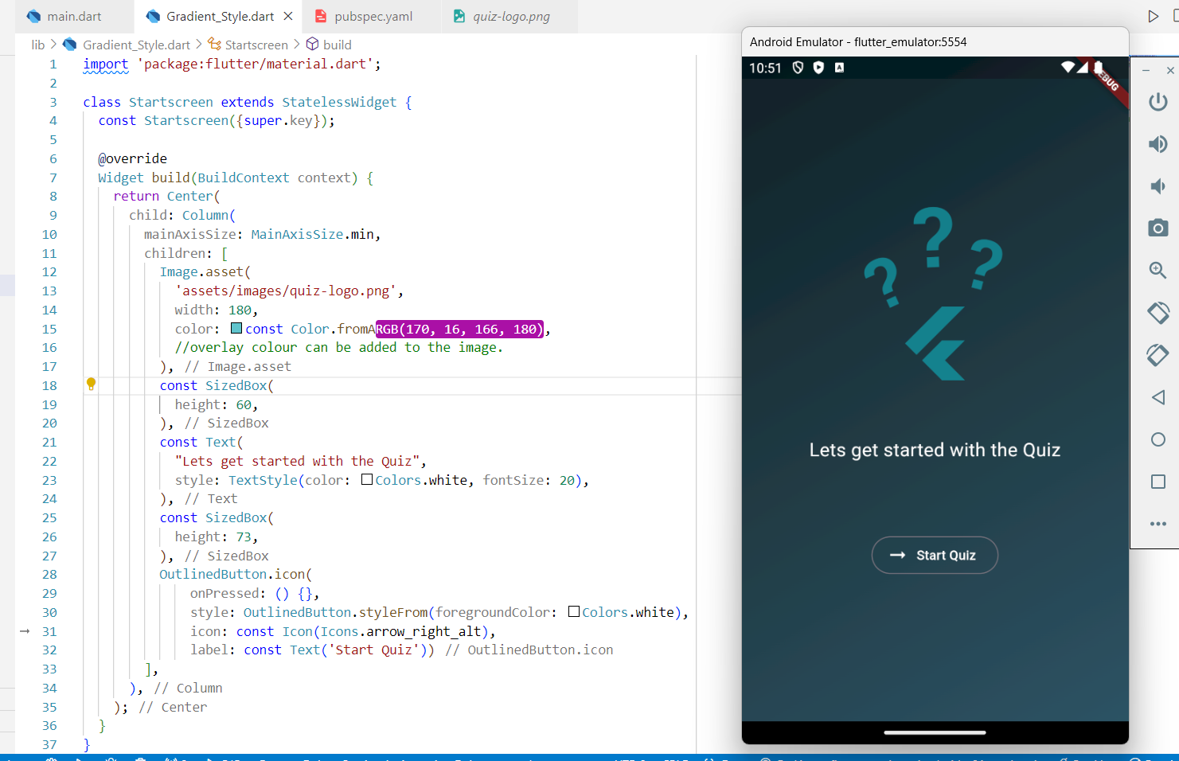
You can also edit the way ur image looks using color property inside the image asset function also opacity can be used reference in comments below.
//Sized box added to create space between text and image here
//use opacity to make the image more transparrent or more opaque this is an approach
/*Opacity(
opacity: 0.3,
child: Image.asset(
'assets/images/quiz-logo.png',
width: 180,
),
),*/

Slide 8
class Startscreen extends StatelessWidget {
const Startscreen({super.key});
@override
Widget build(BuildContext context) {
return Center(
child: Column(
mainAxisSize: MainAxisSize.min,
children: [
Image.asset(
'assets/images/quiz-logo.png',
width: 180,
color: const Color.fromARGB(170, 16, 166, 180),
//overlay colour can be added to the image.
),
const SizedBox(
height: 60,
),
const Text(
"Lets get started with the Quiz",
style: TextStyle(color: Colors.white, fontSize: 20),
),
const SizedBox(
height: 73,
),
OutlinedButton.icon(
onPressed: () {},
style: OutlinedButton.styleFrom(foregroundColor: Colors.white),
icon: const Icon(Icons.arrow_right_alt),
label: const Text('Start Quiz'))
],
),
);
}
}
import 'package:flutter/material.dart';
import 'package:quiz_app/Gradient_Style.dart';
// Ensure this path is correct
//import 'Startscreen.dart'; // Import the Startscreen widget
void main() {
runApp(
MaterialApp(
home: Scaffold(
body: Container(
decoration: const BoxDecoration(
gradient: LinearGradient(
colors: [
Color(0xFF0F2027), // Dark Blue
Color(0xFF203A43), // Medium Blue
Color(0xFF2C5364), // Lighter Blue
],
begin: Alignment.topLeft,
end: Alignment.bottomRight,
),
),
child: const Startscreen(),
),
),
),
);
}

Slide 9
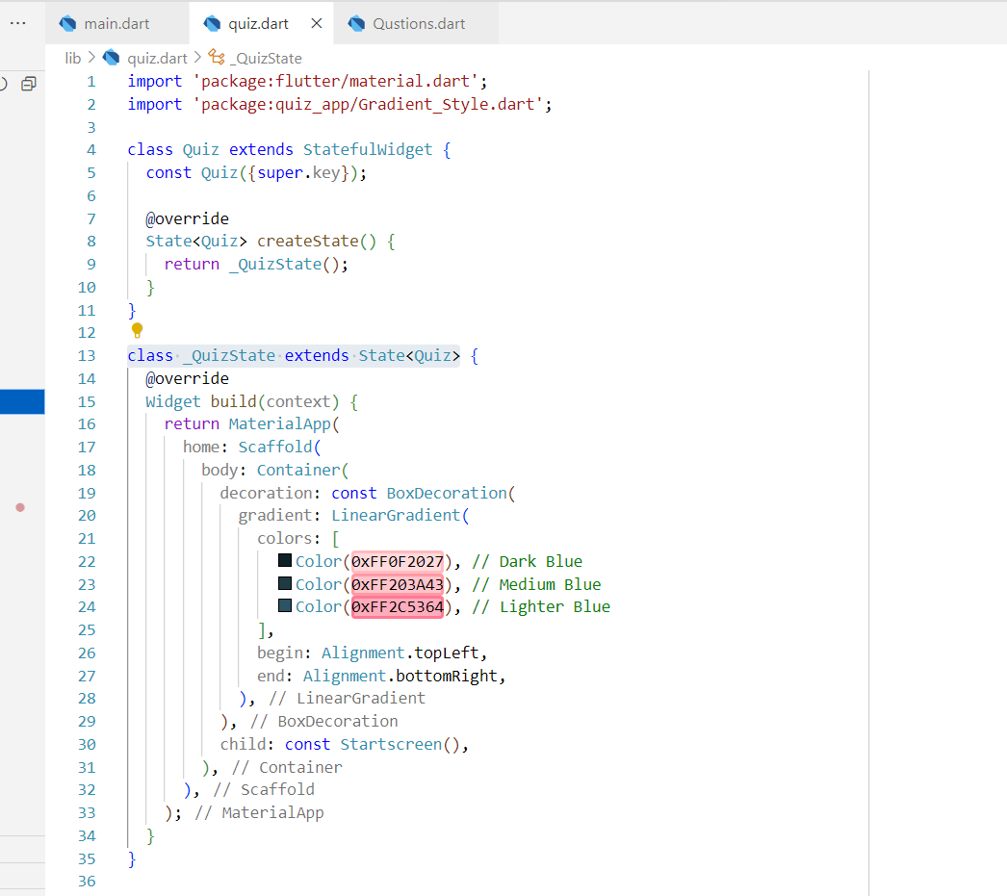
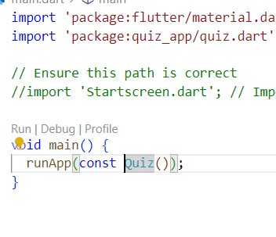
In the next step since I want my start quiz button to change I brought the material app into the quiz state class which is connected to the Quiz class above.
Therefore in main above I call Quiz app inside the run app .
This has nothing to do with any changes on screen however this is just for the start quiz button should be inside stateful class.

Slide 10
import 'package:flutter/material.dart';
import 'package:flutter/widgets.dart';
import 'package:quiz_app/Gradient_Style.dart';
import 'package:quiz_app/Qustions.dart';
class Quiz extends StatefulWidget {
const Quiz({super.key});
@override
State<Quiz> createState() {
return _QuizState();
}
}
class _QuizState extends State<Quiz> {
Widget activeScreen = const Startscreen();
void switchScreen() {
setState(() {
activeScreen = const QuestionsScreen();
});
}
@override
Widget build(context) {
return MaterialApp(
home: Scaffold(
body: Container(
decoration: const BoxDecoration(
gradient: LinearGradient(
colors: [
Color(0xFF0F2027), // Dark Blue
Color(0xFF203A43), // Medium Blue
Color(0xFF2C5364), // Lighter Blue
],
begin: Alignment.topLeft,
end: Alignment.bottomRight,
),
),
child: activeScreen,
),
),
);
}
}
Here added the switch screen function inside the Quiz state allowing the screen to switch to the questions page when button is pressed.
As you can also see a widget can be stored inside the variable to easily access them without issues.

Slide 11
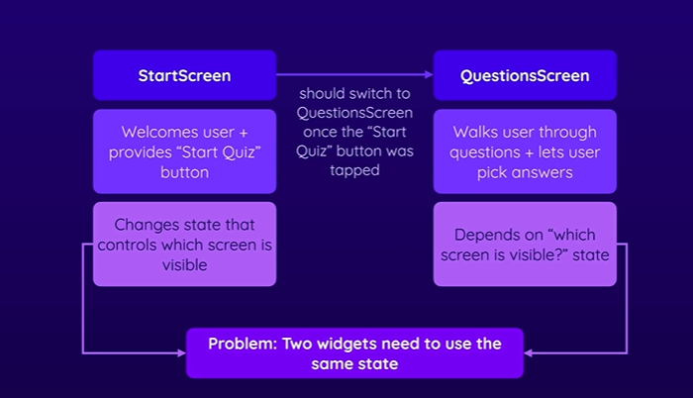
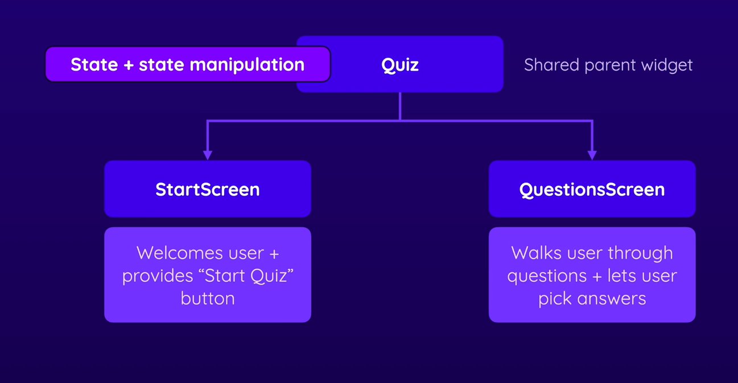
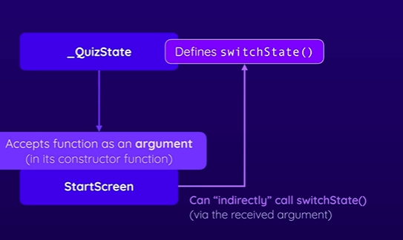

Slide 12
class _QuizState extends State<Quiz> {
Widget activeScreen = const Startscreen(switchScreen);
void switchScreen() {
setState(() {
activeScreen = const QuestionsScreen();
});
}
@override
Widget build(context) {
return MaterialApp(
home: Scaffold(
body: Container(
decoration: const BoxDecoration(
gradient: LinearGradient(
colors: [
Color(0xFF0F2027), // Dark Blue
Color(0xFF203A43), // Medium Blue
Color(0xFF2C5364), // Lighter Blue
],
begin: Alignment.topLeft,
end: Alignment.bottomRight,
),
),
child: activeScreen,
),
),
);
}
}
import 'package:flutter/material.dart';
class Startscreen extends StatelessWidget {
const Startscreen(this.startQuiz, {super.key});
//using a postional arugument to the start screen widget here so when we pass a void type function it gets executed
final void Function() startQuiz;
@override
Widget build(BuildContext context) {
return Center(
child: Column(
mainAxisSize: MainAxisSize.min,
children: [
Image.asset(
'assets/images/quiz-logo.png',
width: 180,
color: const Color.fromARGB(170, 16, 166, 180),
//overlay colour can be added to the image.
),
const SizedBox(
height: 60,
),
const Text(
"Lets get started with the Quiz",
style: TextStyle(color: Colors.white, fontSize: 20),
),
const SizedBox(
height: 73,
),
OutlinedButton.icon(
onPressed: () {
startQuiz(); //input argument is a function and now we can execute it here that means when pressed the quiz should start
},
style: OutlinedButton.styleFrom(foregroundColor: Colors.white),
icon: const Icon(Icons.arrow_right_alt),
label: const Text('Start Quiz'))
],
),
);
}
Here we are passing the switch screen function to the startscreen widget where the button is there to initate a screen or to execute the function on press to switch screen

Slide 13
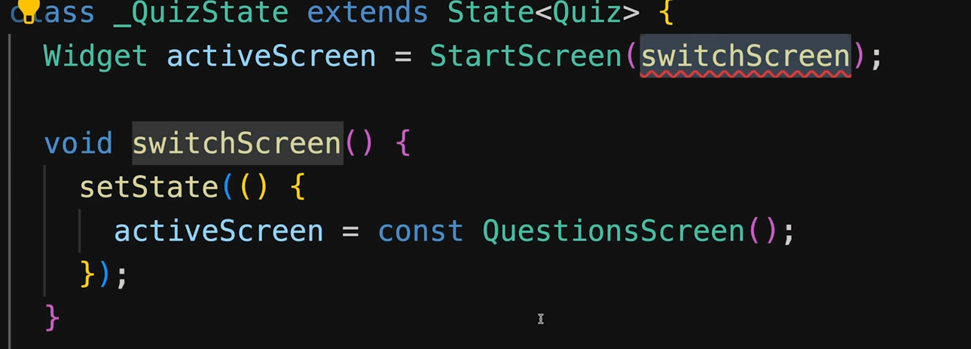
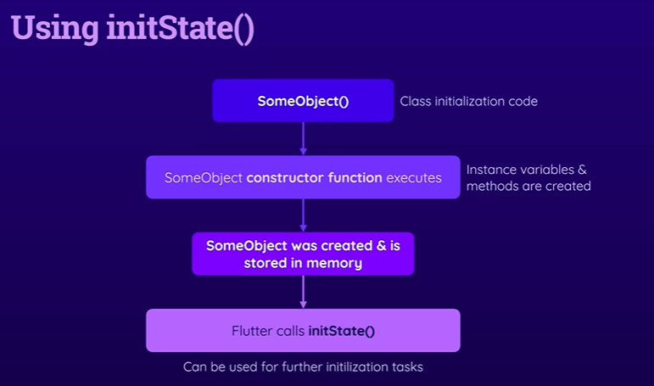
As you can see it is too early to pass the function to the startscreen widget so use init function which takes care of the initizialization of that function so now u can use that switchscreen when the widget becomes an object.
And after the constructor function executes the init state will be called after the object is created

Slide 14
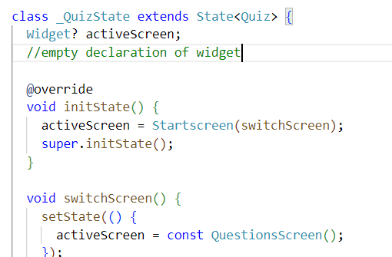
Deep Dive: Flutter's (Stateful) Widget Lifecycle
Every Flutter Widget has a built-in lifecycle: A collection of methods that are automatically executed by Flutter (at certain points of time).
There are three extremely important (stateful) widget lifecycle methods you should be aware of:
initState(): Executed by Flutter when the StatefulWidget's State object is initialized
build(): Executed by Flutter when the Widget is built for the first time AND after setState() was called
dispose(): Executed by Flutter right before the Widget will be deleted (e.g., because it was displayed conditionally)
You will encounter them all multiple times throughout the course - therefore you don't have to memorize them now and you will see them in action. It's still worth learning about them right now already.

Slide 15
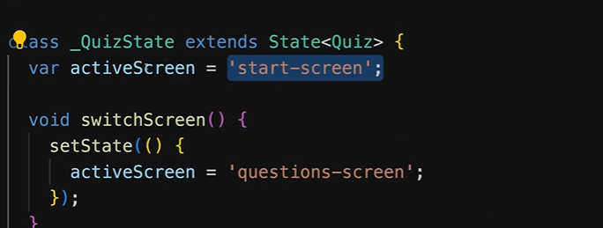
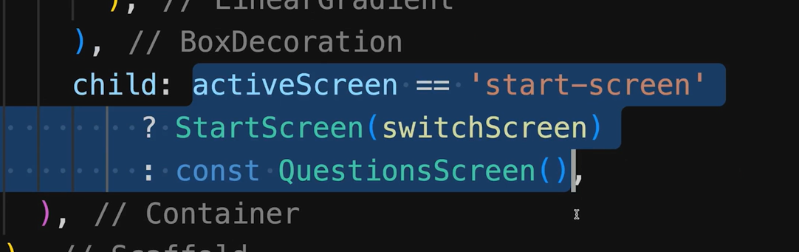
Alternate approach to switching screens using a ternary operator

Slide 16
import 'package:flutter/material.dart';
import 'package:flutter/widgets.dart';
import 'package:quiz_app/Gradient_Style.dart';
import 'package:quiz_app/Qustions.dart';
class Quiz extends StatefulWidget {
const Quiz({super.key});
@override
State<Quiz> createState() {
return _QuizState();
}
}
class _QuizState extends State<Quiz> {
var activeScreen = 1;
//empty declaration of widget
/*
@override
void initState() {
activeScreen = Startscreen(switchScreen);
super.initState();
}*/
void switchScreen() {
setState(() {
activeScreen = 2;
});
}
@override
Widget build(context) {
Widget screenWidget = Startscreen(switchScreen);
if (activeScreen == 2) {
screenWidget = const QuestionsScreen();
}
return MaterialApp(
home: Scaffold(
body: Container(
decoration: const BoxDecoration(
gradient: LinearGradient(
colors: [
Color(0xFF0F2027), // Dark Blue
Color(0xFF203A43), // Medium Blue
Color(0xFF2C5364), // Lighter Blue
],
begin: Alignment.topLeft,
end: Alignment.bottomRight,
),
),
child: screenWidget,
),
),
);
}
}
Alternative approach to change /switch screens using if keyword
Declare active screen variable to be a string/int value.
After that inside the build you create a widget variable where you can pass the startscreen(switchscreen)object
Initially the screen state is 1 but when the button is pressed the value switches to 2 and the page switches to questions screen.

Slide 17
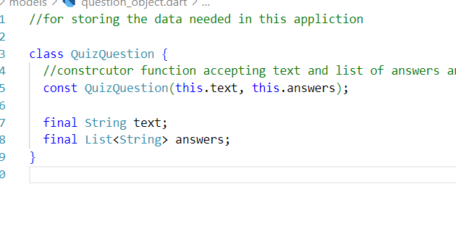
Im making a class of question to create a question object and use it in our program.

Slide 18
import 'package:quiz_app/models/question_object.dart';
const questions = [
QuizQuestion(
'What are the main building blocks of Flutter UIs?',
[
'Widgets',
'Components',
'Blocks',
'Functions',
],
),
QuizQuestion('How are Flutter UIs built?', [
'By combining widgets in code',
'By combining widgets in a visual editor',
'By defining widgets in config files',
'By using XCode for iOS and Android Studio for Android',
]),
QuizQuestion(
'What\'s the purpose of a StatefulWidget?',
[
'Update UI as data changes',
'Update data as UI changes',
'Ignore data changes',
'Render UI that does not depend on data',
],
),
This is the example of the question object we made out the class which consists of data which stored in a different folder.

Slide 19
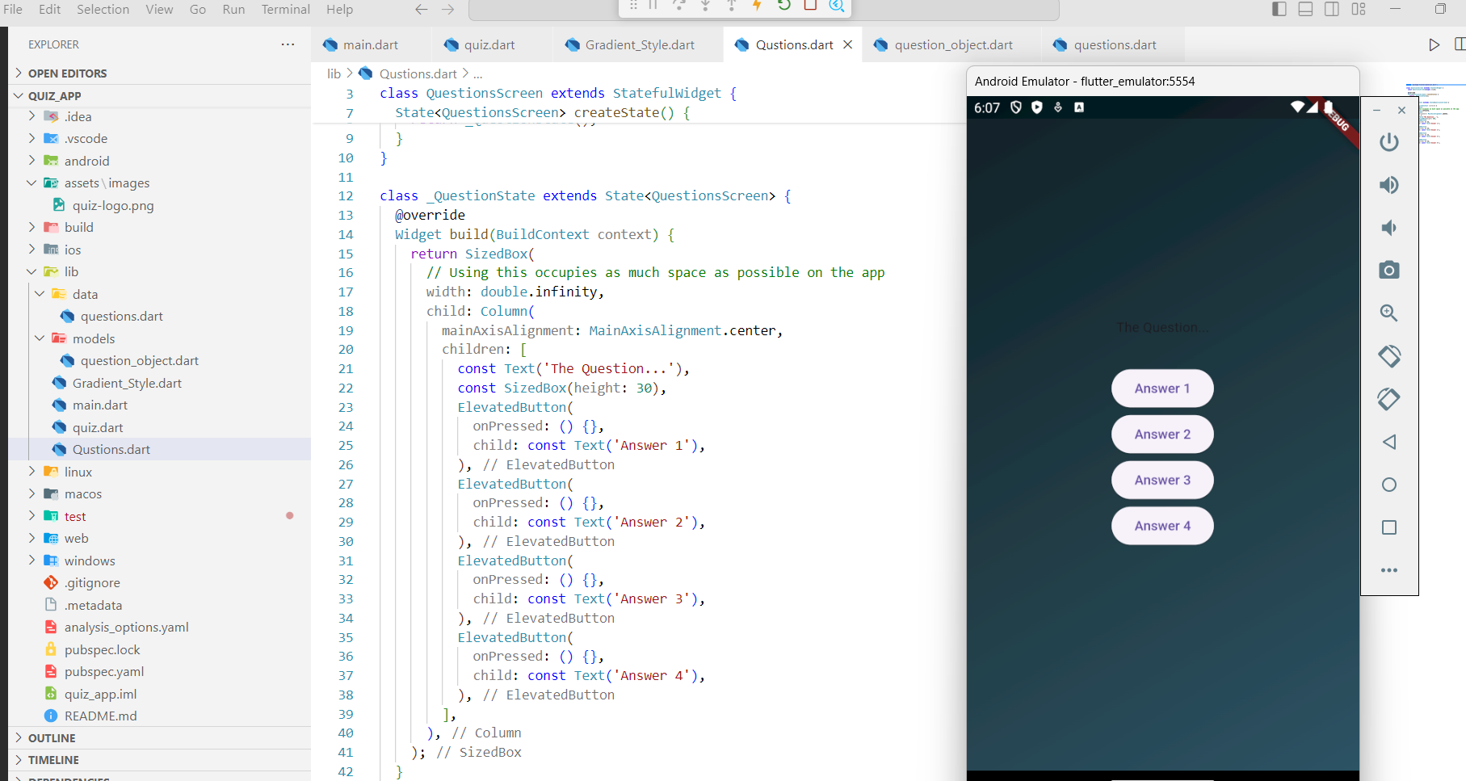
Now we have the questions screen settled here.
A model which our app will look like in the end.

Slide 20
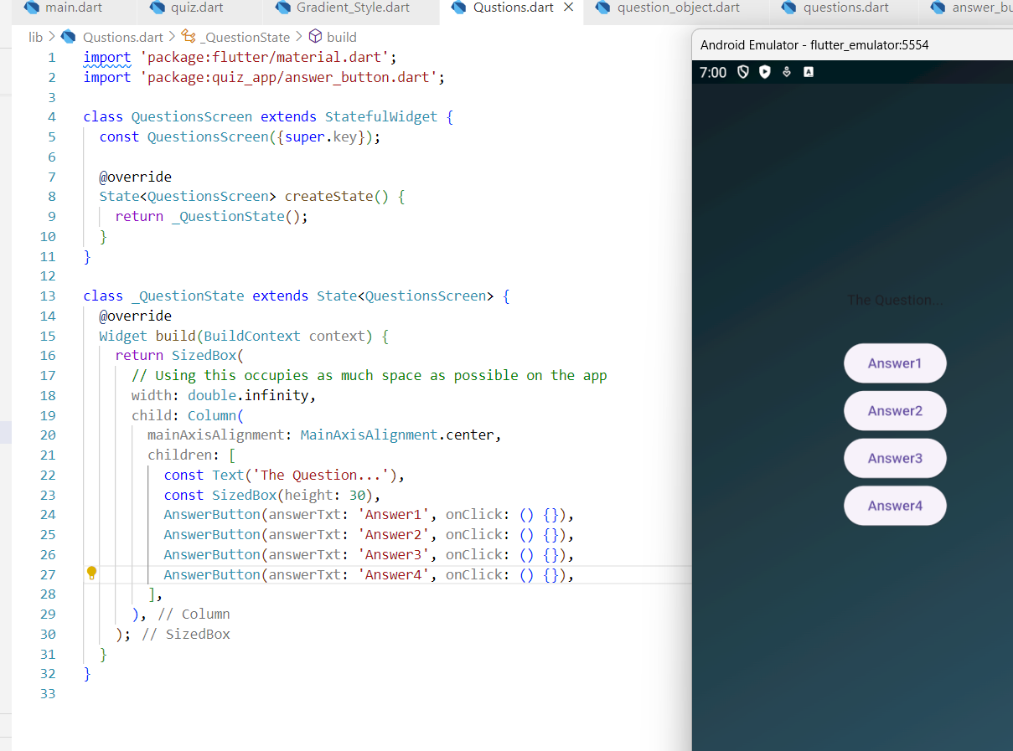
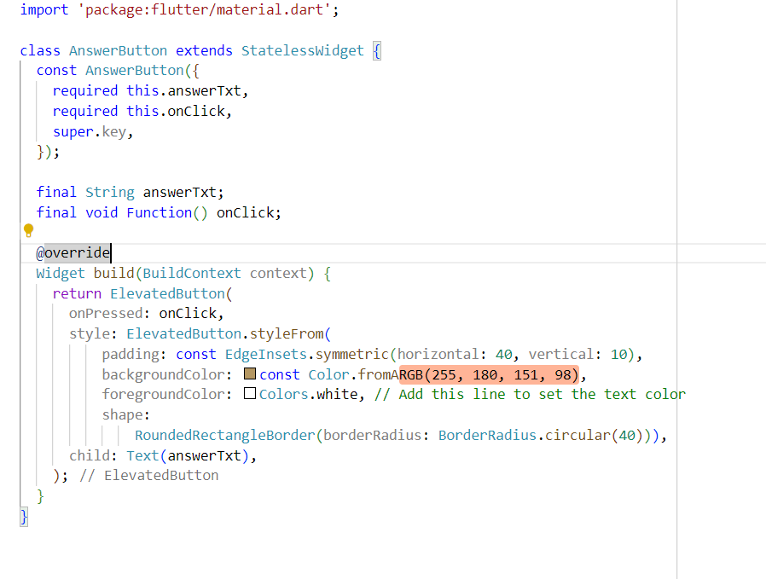
If there are multiple buttons needed just use this method.

Slide 21
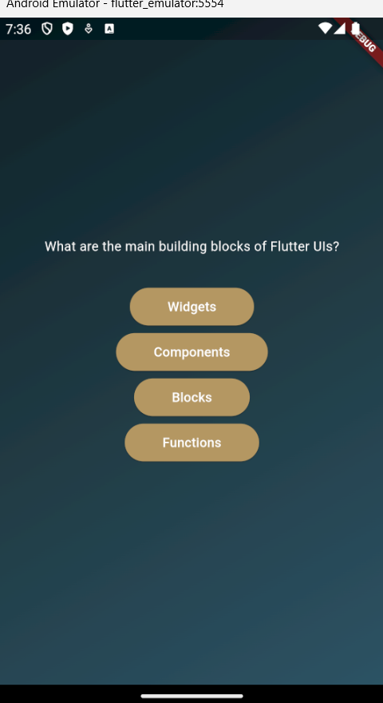
This is how we pass the data from data folder into the place where we want the data to reflect. First question is ready
import 'package:flutter/material.dart';
import 'package:quiz_app/answer_button.dart';
//step 1 bring those data into here
import 'package:quiz_app/data/questions.dart';
class QuestionsScreen extends StatefulWidget {
const QuestionsScreen({super.key});
@override
State<QuestionsScreen> createState() {
return _QuestionState();
}
}
class _QuestionState extends State<QuestionsScreen> {
@override
Widget build(BuildContext context) {
final currentQuestion = questions[0];
return SizedBox(
// Using this occupies as much space as possible on the app
width: double.infinity,
child: Column(
mainAxisAlignment: MainAxisAlignment.center,
children: [
Text(
currentQuestion.text,
style: const TextStyle(color: Colors.white),
),
const SizedBox(height: 30),
AnswerButton(answerTxt: currentQuestion.answers[0], onClick: () {}),
AnswerButton(answerTxt: currentQuestion.answers[1], onClick: () {}),
AnswerButton(answerTxt: currentQuestion.answers[2], onClick: () {}),
AnswerButton(answerTxt: currentQuestion.answers[4], onClick: () {}),
],
),
);
}
}

Slide 22
class _QuestionState extends State<QuestionsScreen> {
@override
Widget build(BuildContext context) {
final currentQuestion = questions[0];
return SizedBox(
// Using this occupies as much space as possible on the app
width: double.infinity,
child: Column(
mainAxisAlignment: MainAxisAlignment.center,
children: [
Text(
currentQuestion.text,
style: const TextStyle(color: Colors.white),
),
const SizedBox(height: 30),
//...built in keyword are pulled and added as individual elements
...currentQuestion.answers.map((answer) {
return AnswerButton(
answerTxt: answer,
onClick: () {},
);
})
],
),
);
}
}
Answer button have been pulled out and used as individual elements because list is not supported inside children class.
Deriving answer buttons dynamically.

Slide 23
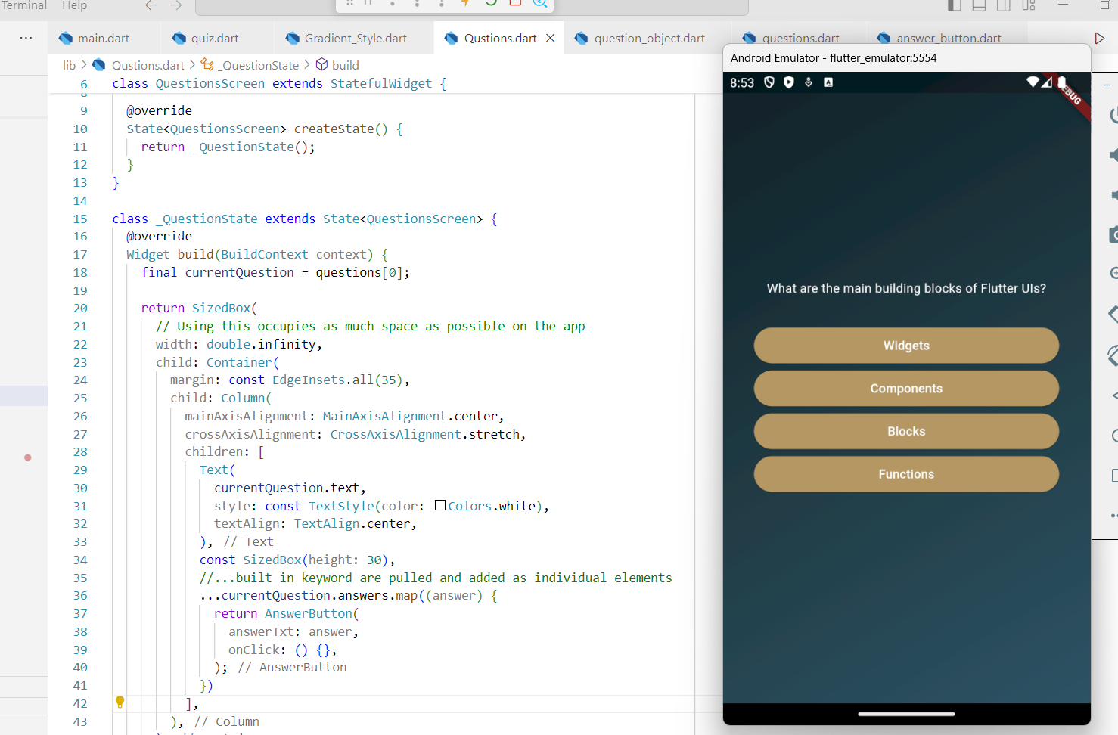
More changes to the ui by changing the style of the buttons and aligning the text to the centre to look good.

Slide 24
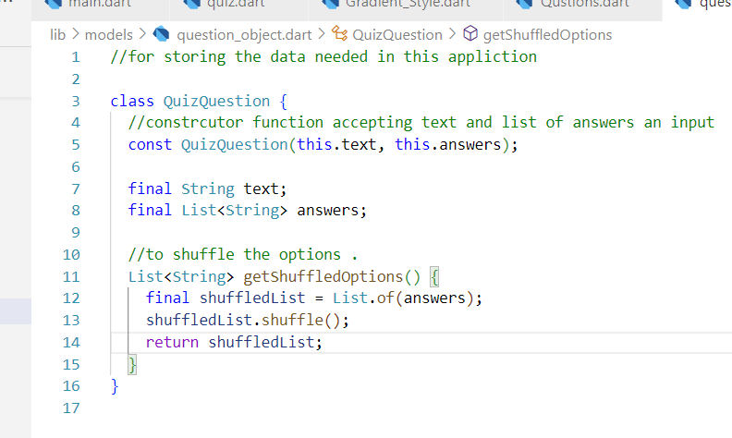
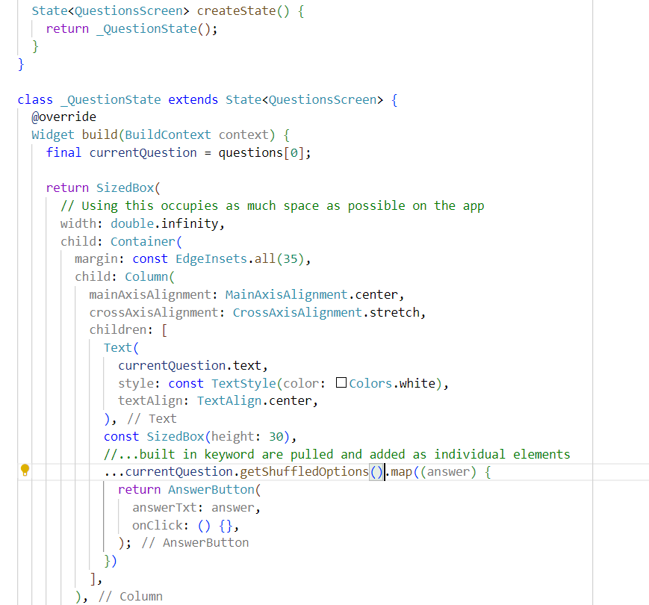
Shuffled list cannot be reassigned to create new list however this will be used to shuffle the answers/options on screen each time we refresh , check below how to use common practice.

Slide 25
import 'package:flutter/material.dart';
import 'package:quiz_app/answer_button.dart';
//step 1 bring those data into here
import 'package:quiz_app/data/questions.dart';
class QuestionsScreen extends StatefulWidget {
const QuestionsScreen({super.key});
@override
State<QuestionsScreen> createState() {
return _QuestionState();
}
}
class _QuestionState extends State<QuestionsScreen> {
var questionIndex =
0; //question list starts from zero to 3 for 4 of the options,.
void answerQuestion() {
setState(() {
questionIndex = questionIndex + 1; //count increases
});
// questionIndex = questionIndex + 1; //count increases
} //when we click on it we need to move on to next q
@override
Widget build(BuildContext context) {
final currentQuestion = questions[questionIndex];
return SizedBox(
// Using this occupies as much space as possible on the app
width: double.infinity,
child: Container(
margin: const EdgeInsets.all(35),
child: Column(
mainAxisAlignment: MainAxisAlignment.center,
crossAxisAlignment: CrossAxisAlignment.stretch,
children: [
Text(
currentQuestion.text,
style: const TextStyle(color: Colors.white),
textAlign: TextAlign.center,
),
const SizedBox(height: 30),
//...built in keyword are pulled and added as individual elements
...currentQuestion.getShuffledOptions().map((answer) {
return AnswerButton(
answerTxt: answer,
onClick:
answerQuestion, //call the answer function here to move onto next question once ans is taken.
);
})
],
),
),
);
}
}

Slide 26
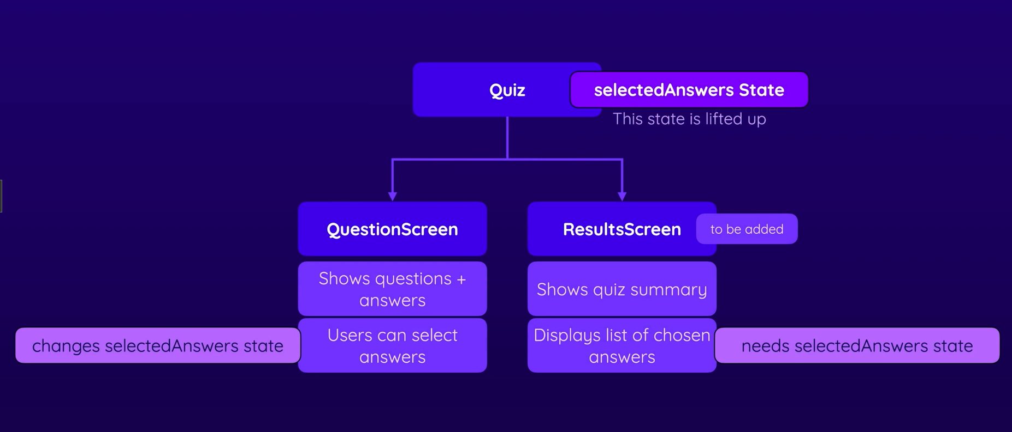

Slide 27
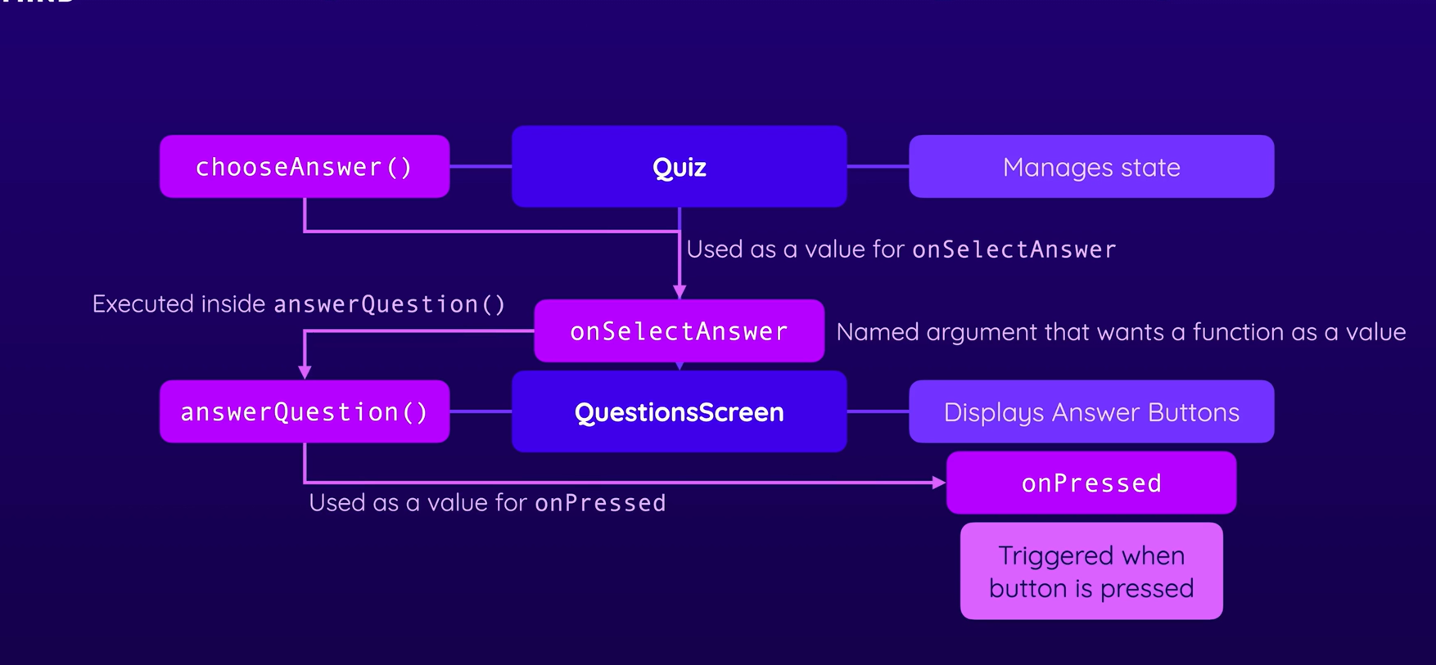

Slide 28
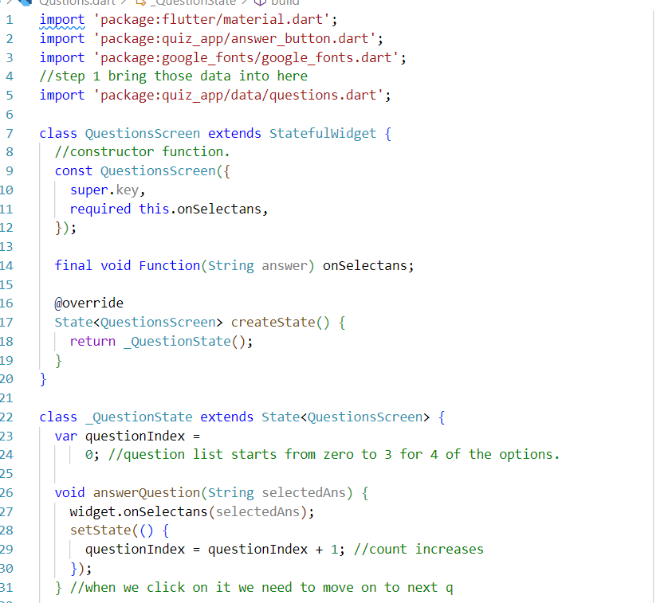
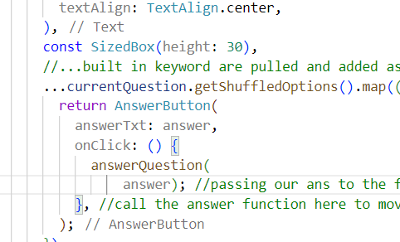
Created a new function inside question state which accepts a string value.
We are going to passing it as an argument to a function.
As you can see selected Ans is being passed into the function. Whenever the question index is increased this should happen.
As you can see when answer is received from button that is passed to this function.

Slide 29
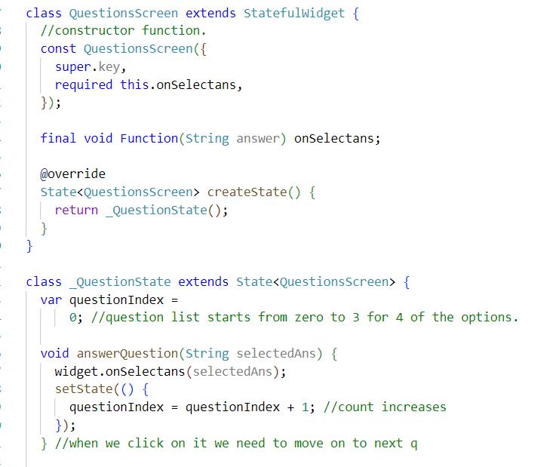
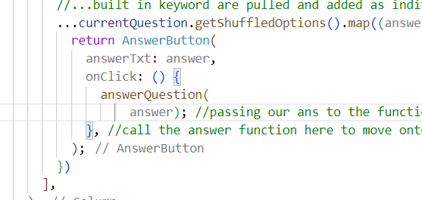
So the concept is we created an empty list inside quiz state to hold the values of the answer received.
We also created a choose answer function : this is basically to be executed when an ans needs to be added to the empty list above
However until this point we have not received answers to store so we add a void function inside question screen widget onselectans here.
Widget.functionname allows us to access this function this should happen when question is incremented .
That means when ans button is clicked here on bottom left answer string will be passed from bottom to top to the empty string on the quiz dart file we created.

Slide 30
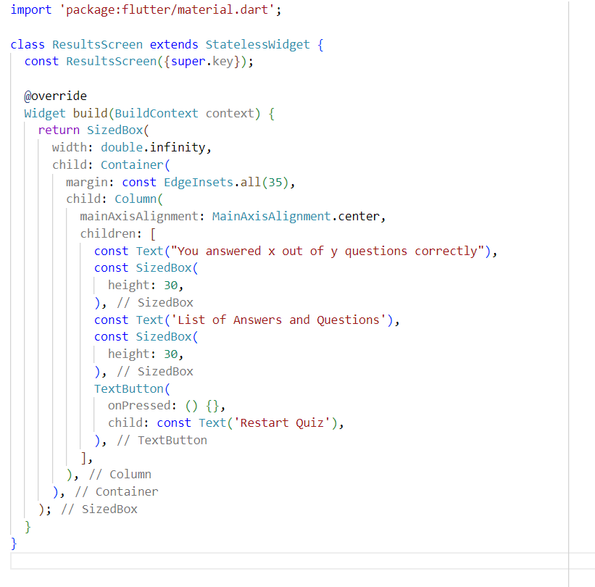
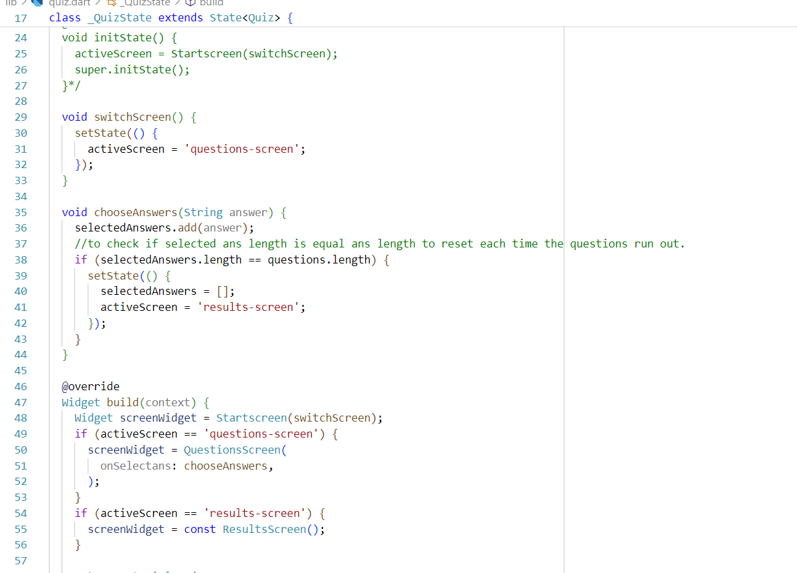
This is how we first create a demo page on results page on the right to look at how the page initially looks.
If selected ans and qns runout the page should be switched to results screen.
Since there is no state it’s a stateless widget, as you can see screenwidget = const Resultsscreen().

Slide 31
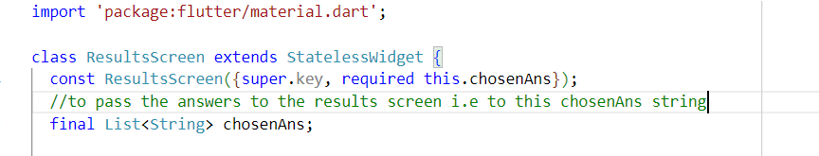
Updated full code in the next slide in the quiz .dart file check.

Slide 32
import 'package:flutter/material.dart';
import 'package:flutter/widgets.dart';
import 'package:quiz_app/Gradient_Style.dart';
import 'package:quiz_app/Qustions.dart';
import 'package:quiz_app/data/questions.dart';
import 'package:quiz_app/results_screen.dart';
class Quiz extends StatefulWidget {
const Quiz({super.key});
@override
State<Quiz> createState() {
return _QuizState();
}
}
class _QuizState extends State<Quiz> {
List<String> selectedAnswers = [];
//this will be passed to the results screen
//to hold the values of answers to the questions
var activeScreen = 'start-screen';
//empty declaration of widget
/*
@override
void initState() {
activeScreen = Startscreen(switchScreen);
super.initState();
}*/
void switchScreen() {
setState(() {
activeScreen = 'questions-screen';
});
}
void chooseAnswers(String answer) {
selectedAnswers.add(answer);
//to check if selected ans length is equal ans length to reset each time the questions run out.
if (selectedAnswers.length == questions.length) {
setState(() {
selectedAnswers = [];
activeScreen = 'results-screen';
});
}
}
@override
Widget build(context) {
Widget screenWidget = Startscreen(switchScreen);
if (activeScreen == 'questions-screen') {
screenWidget = QuestionsScreen(
onSelectans: chooseAnswers,
);
}
if (activeScreen == 'results-screen') {
screenWidget = ResultsScreen(
//passing the selected ans list to chosen ans here because results screen accepts a string value.
chosenAns: selectedAnswers,
);
}
return MaterialApp(
home: Scaffold(
body: Container(
decoration: const BoxDecoration(
gradient: LinearGradient(
colors: [
Color(0xFF0F2027), // Dark Blue
Color(0xFF203A43), // Medium Blue
Color(0xFF2C5364), // Lighter Blue
],
begin: Alignment.topLeft,
end: Alignment.bottomRight,
),
),
child: screenWidget,
),
),
);
}
}

Slide 33
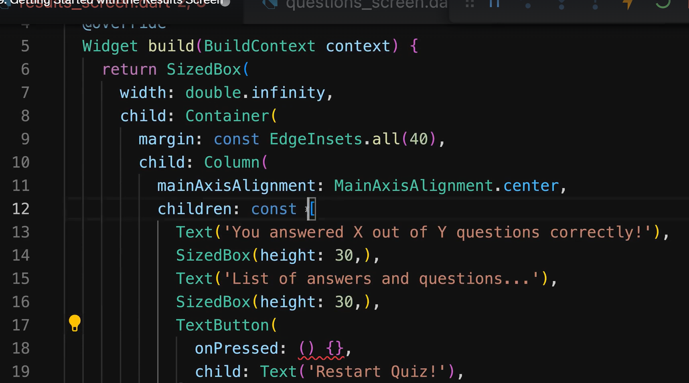
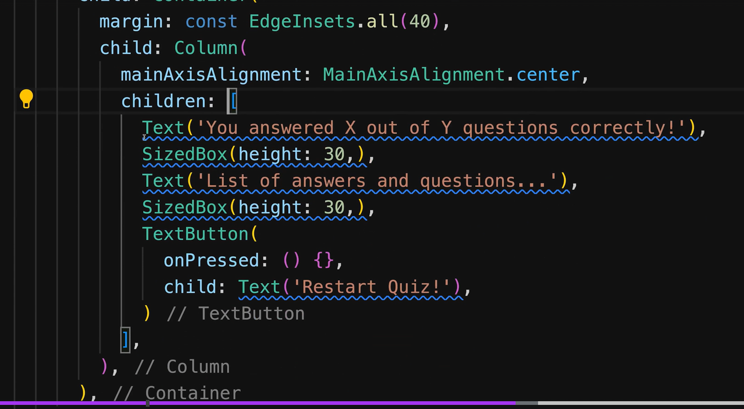
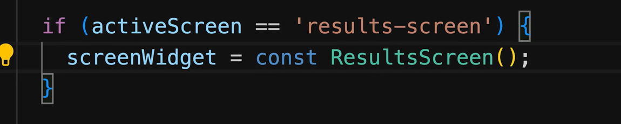

Slide 34
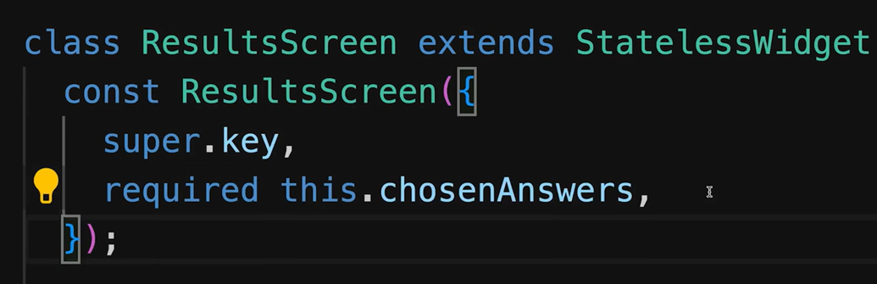
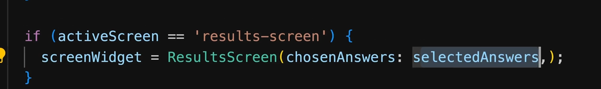
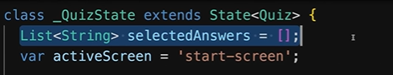
Passing values to the result page

Slide 35
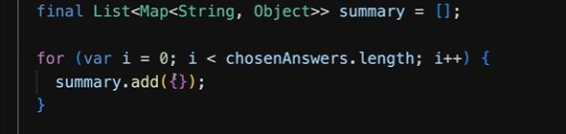
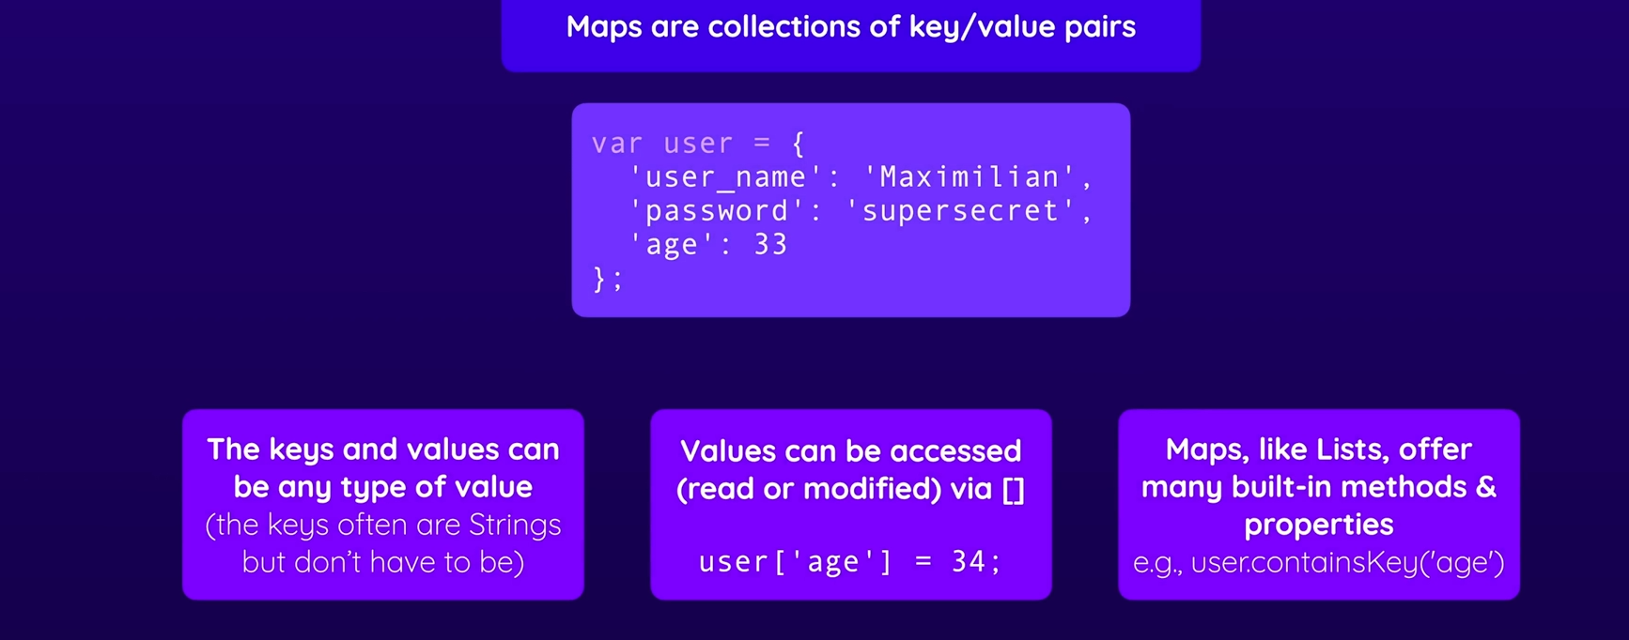
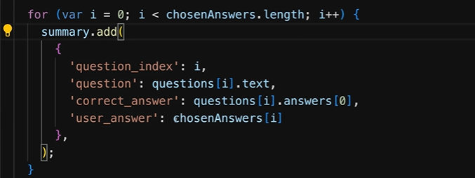
This for loop goes through the answers.
We are mapping questions to a string key.
Mapping the correct Ans : such that first option is correct Ans.
User Ans : chosen answer by the user input.

Slide 36
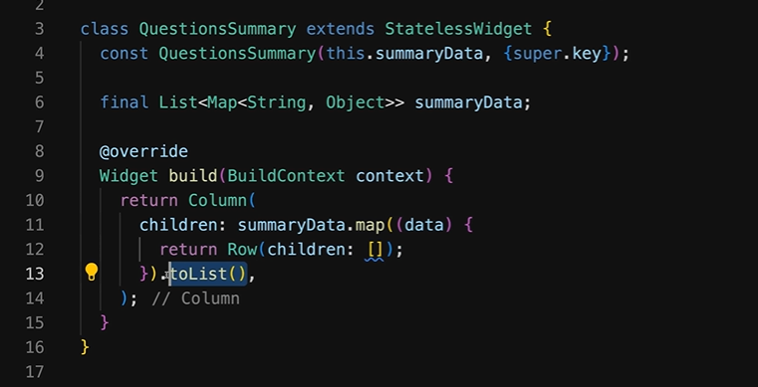
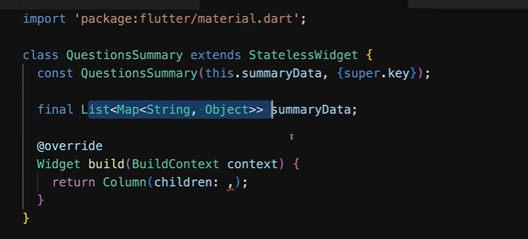
To get the summary data
Note the children class always wants a widget and not iterables therefore summary.map(data).
Tolist() added at the end to pass a list into children because iterable will be converted to list.

Slide 37
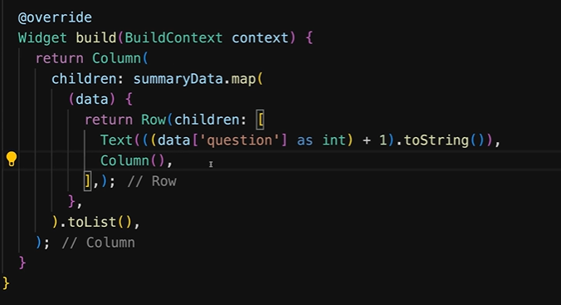
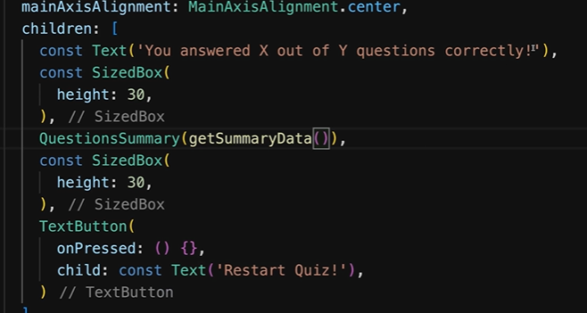
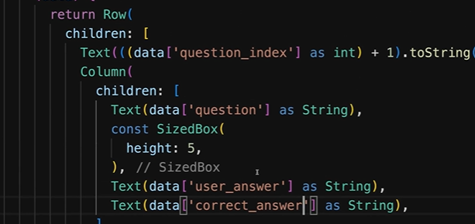
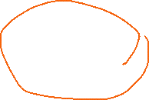
Horizontally displays the rows at question .
Since question index is int and should be shown as a string therefore String→ Question.
For adding question
For adding user answer and what correct ans is.
getSummarydata into Question summary widget from results screen widget /file.

Slide 38
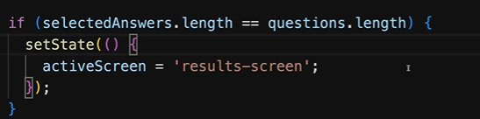



Rmove the empty list from here.
Output so far.
If there is an column inside a row the boundary error to go
Use expanded

Slide 39


Output:

Slide 40

Scroll the page.

